Slide 1
Inline Static Mixers
MCEN 5208: Intro to Research
Fall 2021
Michael DeCapua

Slide 2
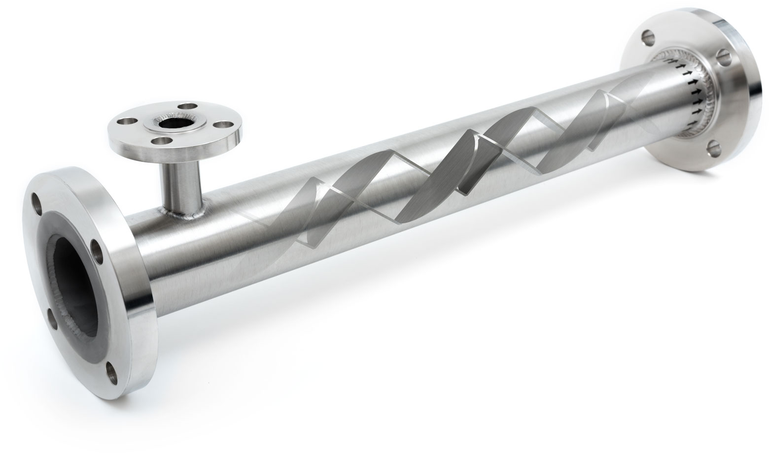
What are Static Mixers?
Static mixers are devices used for continuous mixing of fluid materials, without any moving parts.
This static mixers are used in the water treatment and food processing industry.
Figure 1: Static Mixer from the Koflo Corporation https://www.koflo.com/static-mixers.html

Slide 3
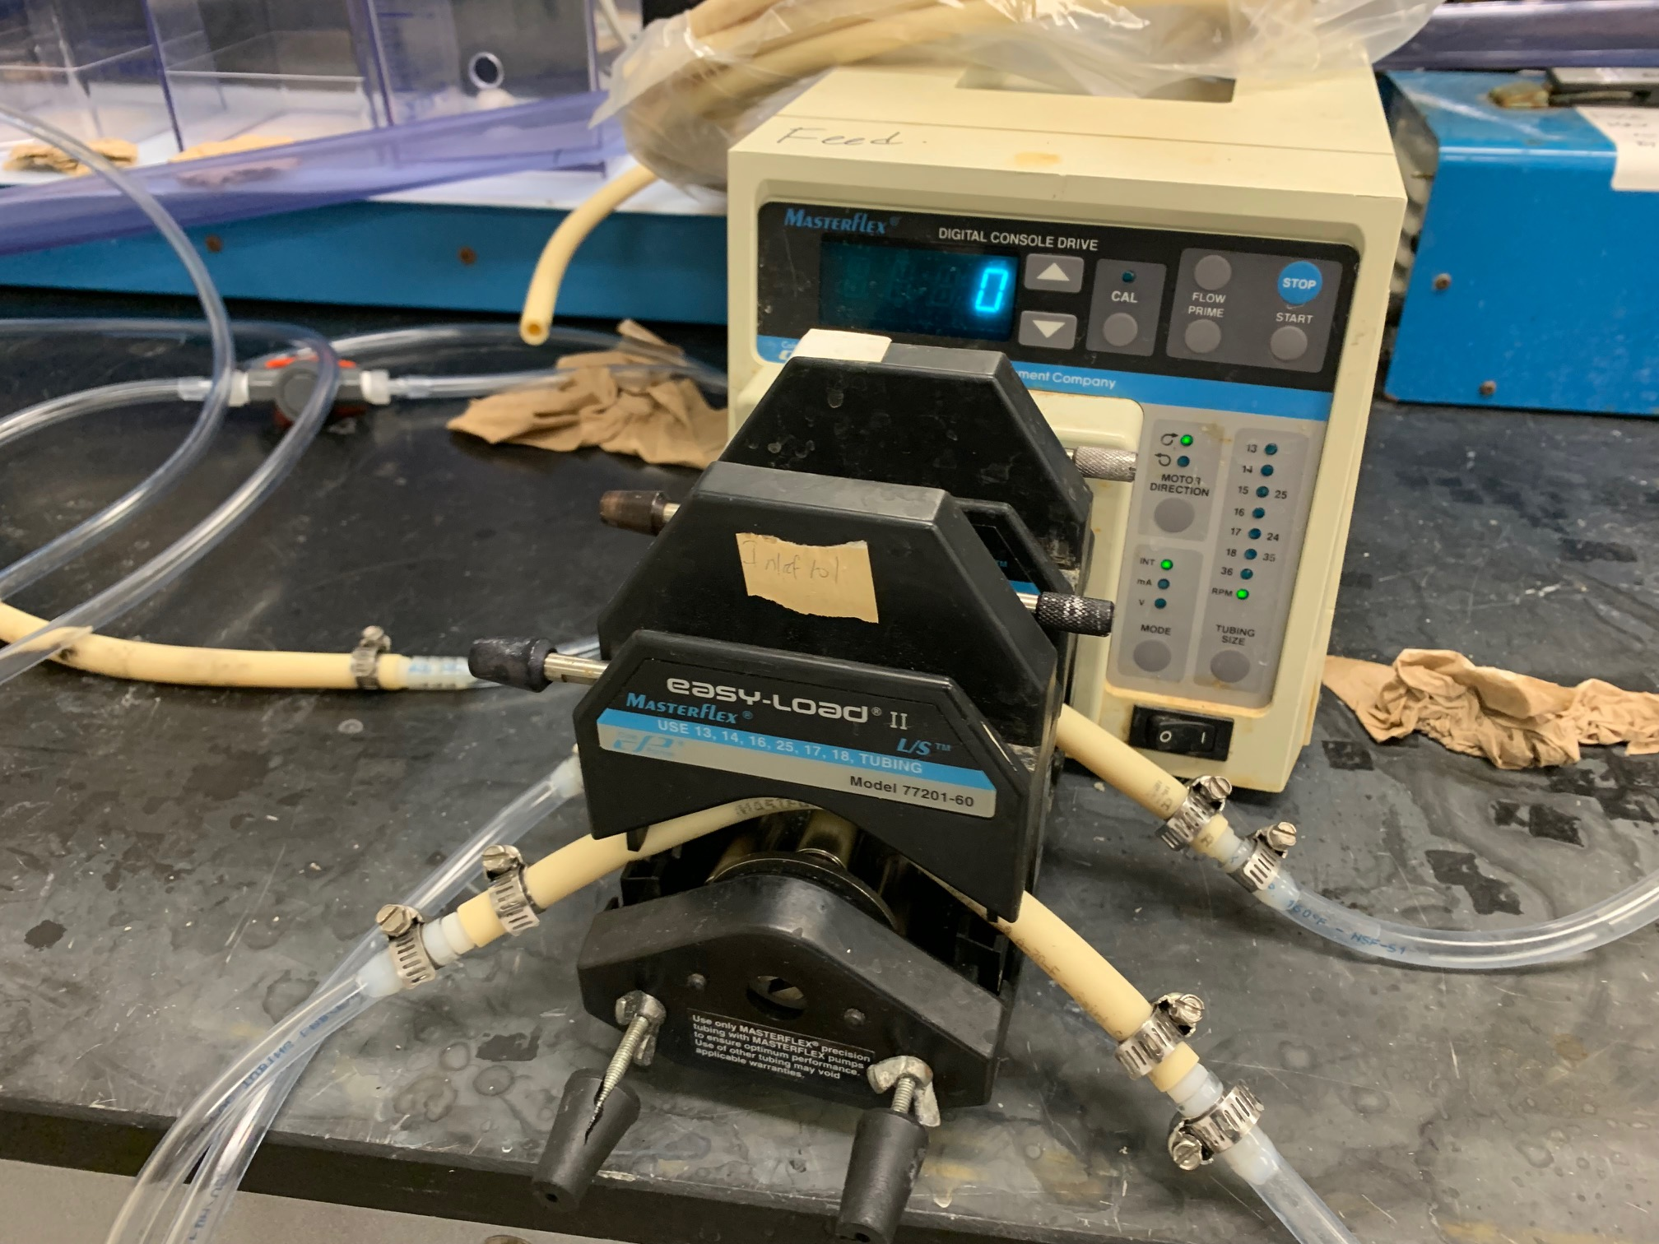
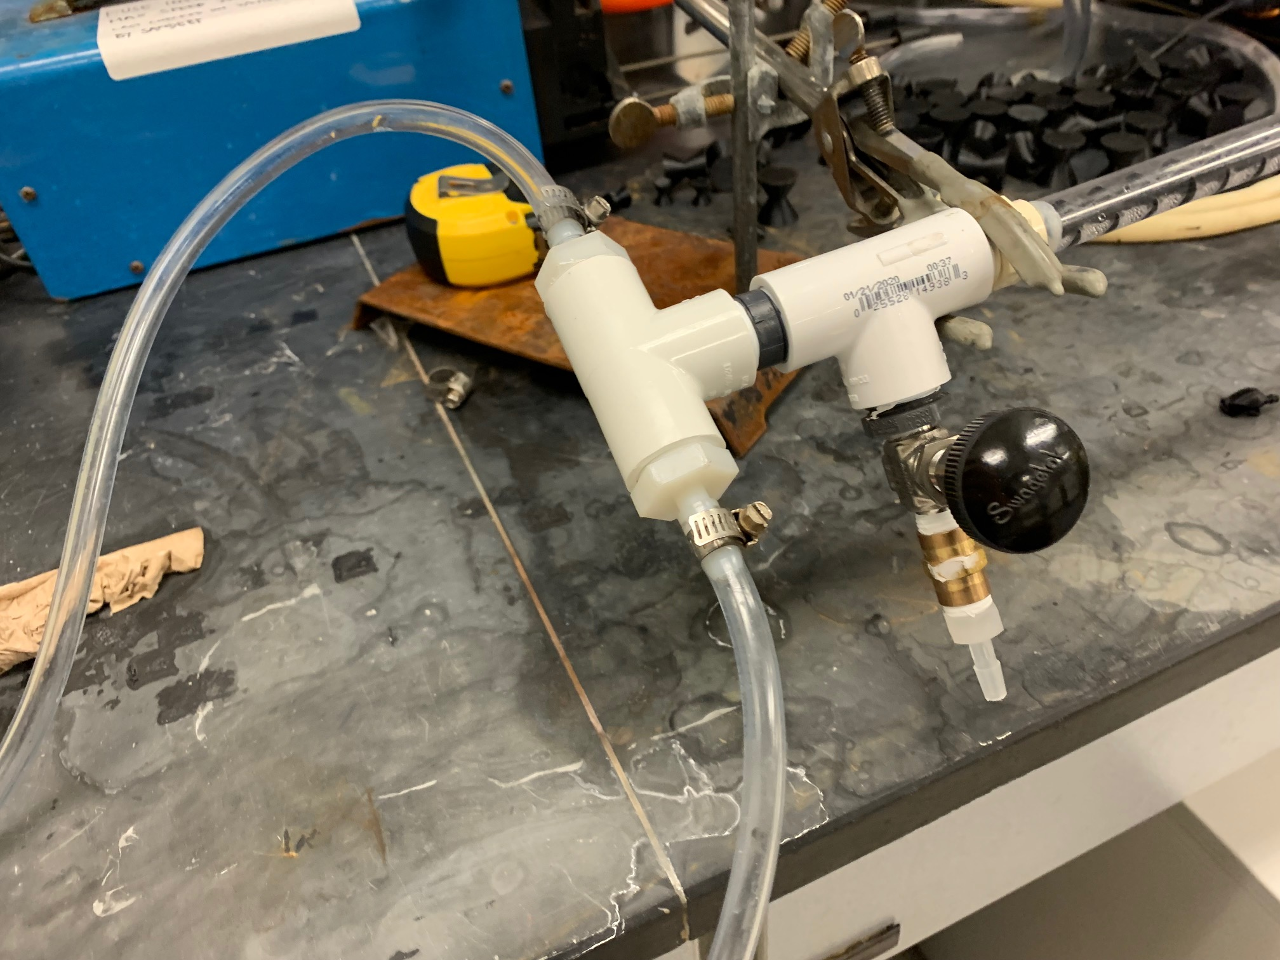
Objectives/Parameters of Mixing
Overall Goal: To model a water treatment method to increase the amount of turbidity in mixture of two salts.
Variables to optimize
Flowrate, Time
Material
Geometry
Concentration of chemicals
Turbidity: Measure of cloudiness
Unit: Nephelometric Turbidity Units (NTUs)
Figure 2: Pump to regulate two flows
Figure 3: T-Joint for two flows entering static mixer

Slide 4
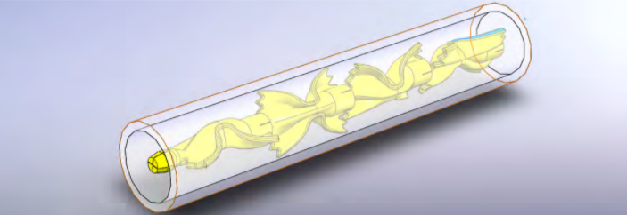
Setup of mixing
Two flows of chemical solutions that are mixed into one tube.
The tube is filled with inline static mixing elements to develop turbulent flow throughout mixing process.
Each trial is tested for turbidity and timed for each element.
Figure 4: Tube with static mixers along the center line

Slide 5
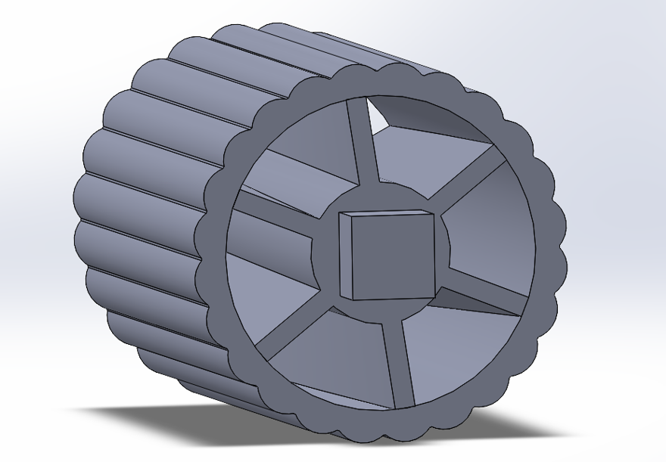
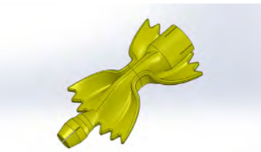
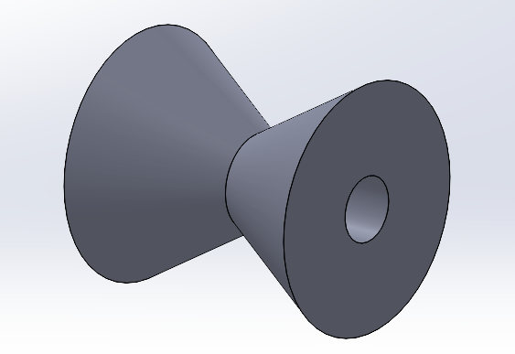
Mixing Elements used in current testing
Rotelle
Farfelle
Hourglass
Figure 5: Rotelle
Figure 6: Farfelle
Figure 7: Hourglass

Slide 6
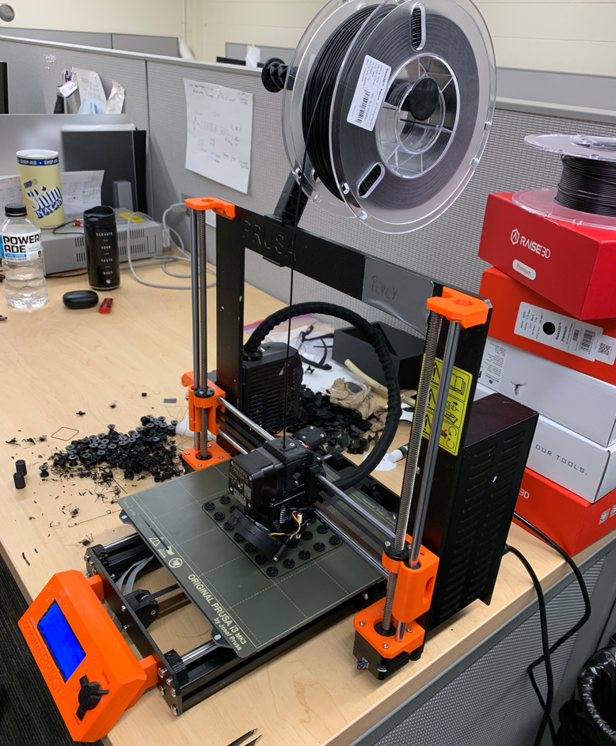
Manufacture of Inline Static Mixing Elements
For these complex geometries (pasta) the group 3D prints each static mixing element using a Prusa i3-mk3.
Materials for 3D print:
Thermoplastic-Polyester (PLA)
Polyethylene terephthalate glycol (PETG)
Polycarbonate (PC)
Polypropylene (PP)
Ethylene Vinyl Alcohol-F (EVOH-F)
Figure 8: Prusa i3-mk3 currently printing Rotelle

Slide 7
Goals forward
Acknowledgements and thank you to...
Test the multiple different static mixing elements to discover which test promotes the most turbidity.
Test the static mixing elements on a PVC rod along the center line to suspend elements along the tube.
CFD testing to find a method of comparing experimental findings to simulation.
Understand what variables promote a high level of turbidity.
Assist in submitting a scientific paper to share our findings with the scientific community.
John Pellegrino, Professor at CU Boulder
Chris Buekle, MS Thesis student of Mechanical Engineering at CU Boulder
Joseph Costello, MS Thesis student of Environmental Engineering at CU Boulder

Slide 8
Q/A?

